Slide 1
﻿Zero-Shot Program Representation Learning
﻿Nan Cui, Yuze Jiang, Xiaodong Gu, Beijun Shen
Shanghai Jiao Tong University
May, 2022
Notes:
Hello everyone, I’m Cui Nan from Shanghai Jiao Tong University. Thanks for listening my presentation. Today I will present my work, Zero-Shot Program Representation Learning.

Slide 2
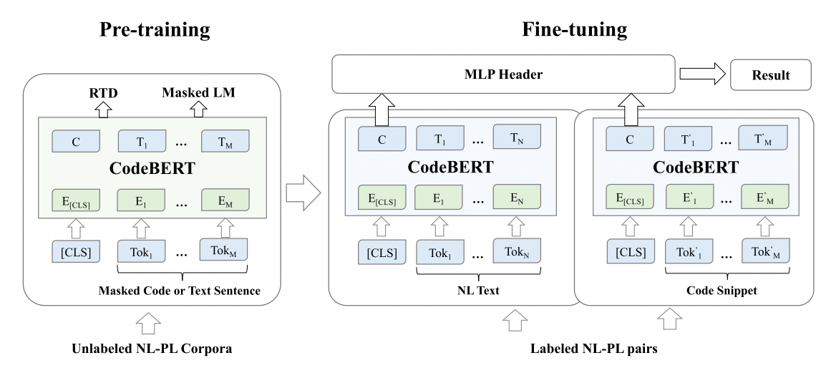
Learning Program Representations
The core prerequisite of code intelligence tasks.
The common prototype: Pre-training on a large-scale code corpora and then fine-tuning on the downstream task.
Notes:
Learning program representations has been the core prerequisite of code intelligence tasks. The state-of-the-art pre-trained models such as CodeBERT require the availability of large-scale code corpora. However, gathering training samples can be costly and infeasible for domain-specific languages such as Solidity for smart contracts. ﻿The large pre-trained model can easily overfit scarce data, which leads to poor task fitting.

Slide 3
The Low-Resource Challenge
However, gathering training samples for the downstream tasks can be costly and infeasible for domain-specific languages (e.g., Solidity).
Unfortunately, I cannot provide you with any example.
Are you crazy?!!
Hmm~ It’s time to show my transformation power.

Slide 4
Zecoler – Zero-Shot Code Representation
Program representation without data labels in the target language.
How?
Prompt learning
Elicit knowledge from PLMs by merely adjusting the input code.
Prediction
PLM
[p₁]…[p_{k}]
void func1(..){
void func2(.){
cloned
Prompt Template
Code 1
Code 2
(optional)
Label
Notes:
In this paper, we propose Zecoler, a novel approach for learning program representations without labelled data samples of the target language. ﻿We employ prompt learning, which adapts the downstream task to the same form as that in pre-training through accompanying trainable prompt tokens with the PLM input. ﻿In this way the model can be adapted to the target language while maximizing the use of prior knowledge learned during the pre-training phase. ﻿Hence, prompt learning allows few-shot or even zero-shot learning for pre-trained models in new languages with unlabelled data.
We conduct extensive experiments on three code intelligence. Results show that our approach significantly outperforms the baseline models.

Slide 5
Workflow
(i) Training
(ii) Usage
Prediction
Prediction
Zecoler
Zecoler
Loss
By employing prompt learning, we train the PLM using large-scale code corpora in popular languages and then directly apply the trained model to tasks in the low-resource language
[p₁]…[p_{k}]
void func1(..){
void func2(.){
cloned
[p₁]…[p_{k}]
void func1(..){
void func2(.){
Prompt Template
Code 1
Code 2
(optional)
Prompt Template
Code 1
Code 2
(optional)
Label
Accompanying trainable prompt tokens into PLM inputs so that the downstream task has the same form as that in pre-training.
Notes:
This figure shows the workflow of Zecoler. By employing prompt learning, we train the PLM using large-scale code corpora in popular languages, like Java, through the converted MLM task, and then directly apply the trained model to tasks in the low-resource language.

Slide 6
Step1: Casting Downstream Tasks into MLM
Insert trainable prompts and [MASK] tokens into inputs
Final Prediction
4%
…
36%
…
0%
no
…
yes
…
map
MLM Header
Verbalizer
clone
MLP+Softmax
90%
yes
not clone
10%
not clone
no
clone
PLM
…
…
Embedding
Prompt Template
void func (..){
[P₁]
[P₂]
int func1 (..) {
[P₃]
[P₄]
[MASK]
Input 1
Prompt
Input 2
Prompt
Notes:
The pipeline of Zecoler is comprised of three steps:
First, we cast any downstream task to the pre-training task by inserting trainable prompts and a “[MASK]” token into the input of the task. The “[MASK]” token acts as a placeholder which steers the pre-trained model to generate the classification result in the code intelligence task.

Slide 7
Step2: Prompt-based Learning
Re-train PLM using using the MLM task
Final Prediction
4%
…
36%
…
0%
no
…
yes
…
map
MLM Header
Verbalizer
clone
MLP+Softmax
90%
yes
not clone
10%
not clone
no
clone
PLM
…
…
Embedding
Prompt Template
void func (..){
[P₁]
[P₂]
int func1 (..) {
[P₃]
[P₄]
[MASK]
Input 1
Prompt
Input 2
Prompt
Notes:
Taking the ﻿resulting data as input, a PLM is then re-trained using the MLM task, that is, infers the program representation of the input and predicts the word for the “[MASK]” token. ﻿

Slide 8
Step3: Revert MLM Outputs to Class Labels
Final Prediction
4%
…
36%
…
0%
no
…
yes
…
map
MLM Header
Verbalizer
clone
MLP+Softmax
90%
yes
not clone
10%
not clone
no
clone
PLM
…
…
Embedding
Prompt Template
void func (..){
[P₁]
[P₂]
int func1 (..) {
[P₃]
[P₄]
[MASK]
Input 1
Prompt
Input 2
Prompt
Notes:
Finally, a verbalizer is employed to cast the predicted word to class labels. ﻿In our approach, we consider two candidate words, yes and no, as a candidate set and only inspect which word in the set is more likely to fill into the “[MASK]” position through PLM predictions. If the word “yes” has a higher probability to fill in the masked position, the verbalizer will map it to the label “true” and hence output a positive prediction for this task.

Slide 9
Evaluation
RQ1: ﻿How effective is our approach in zero-shot program representation learning?
RQ2: ﻿How effective is our approach in few-shot program representation learning?
RQ3: ﻿How effective is our approach in monolingual program representation learning?
RQ4: ﻿How do different hyperparameters impact the performance of our approach?
Notes:
We evaluate our approach on three popular code intelligence tasks, including code clone detection, code search ﻿and method name prediction.
We formulate them as ﻿classification problems and ﻿conduct experiments on four representative datasets, which are preprocessed for the balance of ﻿positive and negative samples.

Slide 10
Downstream Tasks
Cross-Lingual Classification Tasks
Example: Training: Java Clone Detection → Test: Go Clone Detection
Including: Code Search (CS), Code Clone Detection (CD), Method Name Prediction (MNP)
Dataset
Notes:
We evaluate our approach on three popular code intelligence tasks, including code clone detection, code search ﻿and method name prediction.
We formulate them as ﻿classification problems and ﻿conduct experiments on four representative datasets, which are preprocessed for the balance of ﻿positive and negative samples.

Slide 11
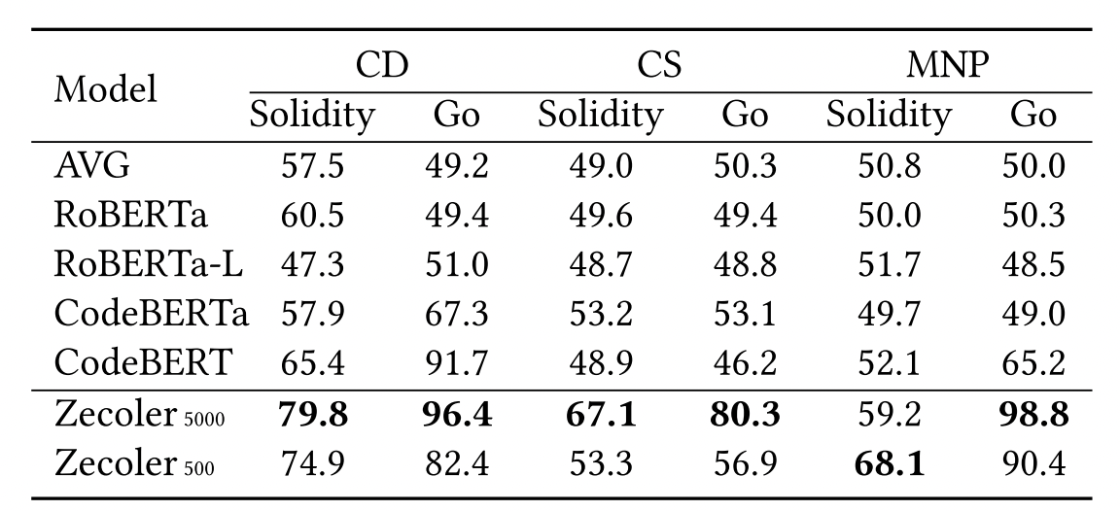
RQ1: Zero-Shot Code Representation Learning
Our approach shows greater performance than baseline models in zero-shot program representation learning.
Notes:
In RQ1 experiment, we compare our approach with five baseline models. We can observe that ﻿our approach shows greater performance than baseline models in code intelligence tasks for no-resource programming languages.

Slide 12
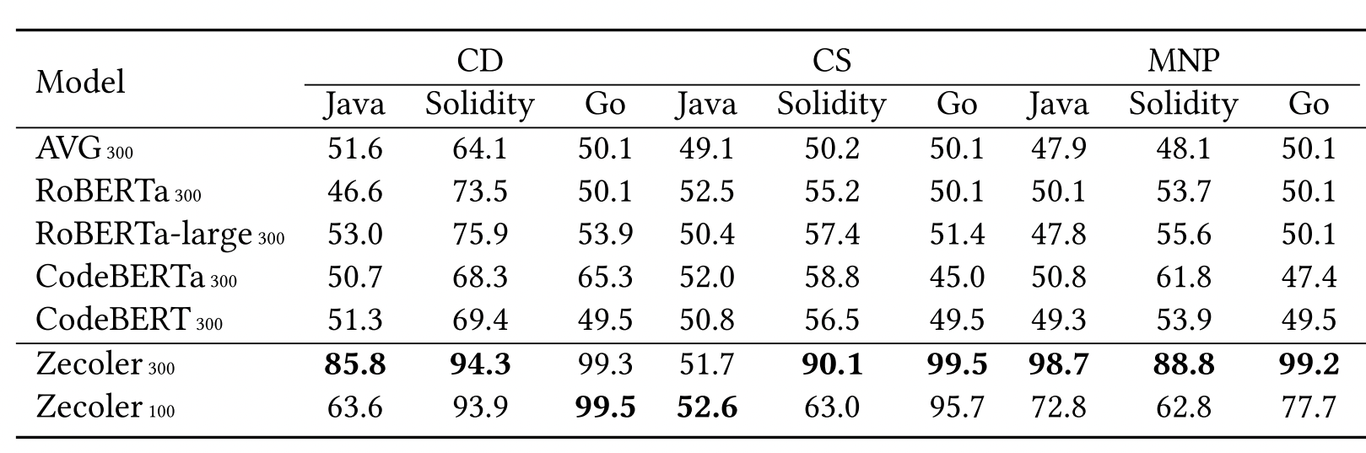
RQ2: Cross-Lingual Few-Shot Learning
Zecoler shows effective performance with a few data samples.
Notes:
In RQ2 experiment, Zecoler shows effective performance with a few data samples. As in zero-shot setting, Zecoler still keeps the best accuracy among all compared models in few-shot setting.

Slide 13
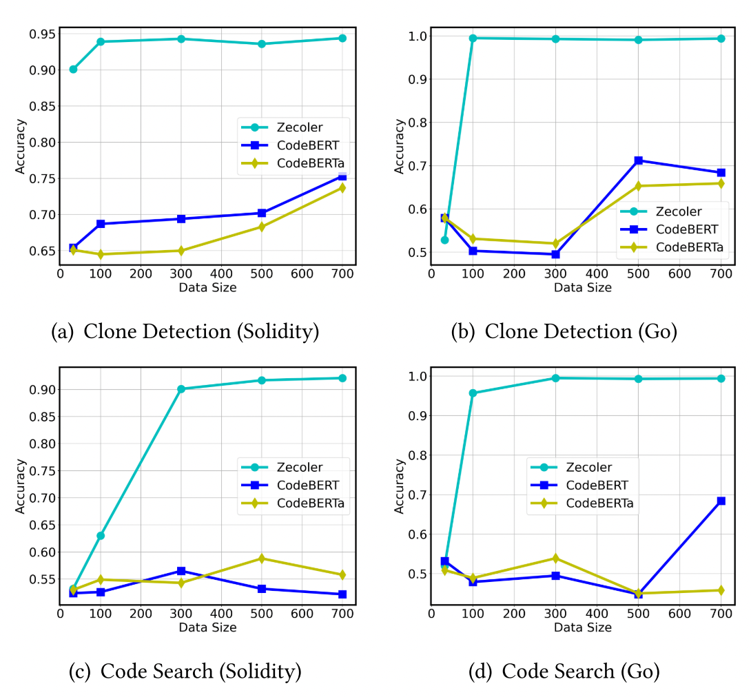
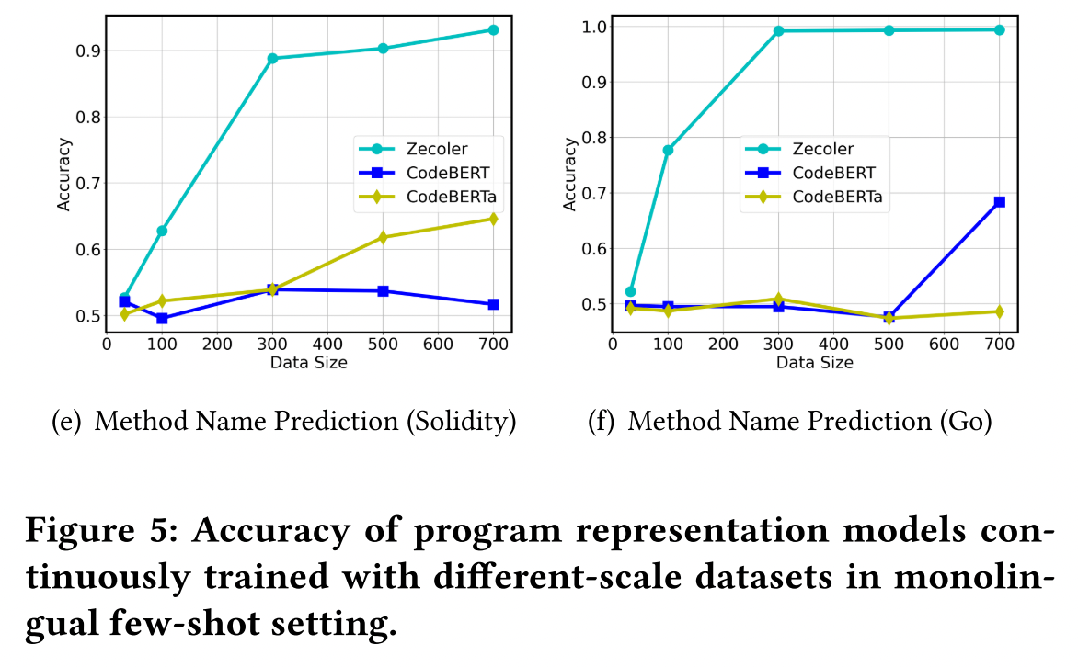
RQ3: Monolingual Few-Shot Learning
Zecoler is effective in monolingual few-shot learning and performs much better than in the cross-language setting.
Notes:
In RQ3, we have also observed that ﻿Zecoler is effective in monolingual few-shot learning, and shows much stronger performance than that in the cross-language setting.

Slide 14
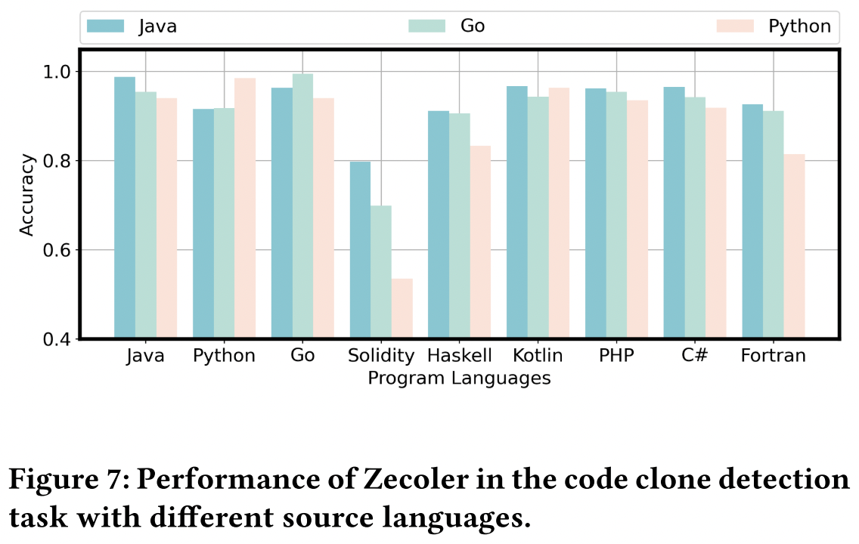
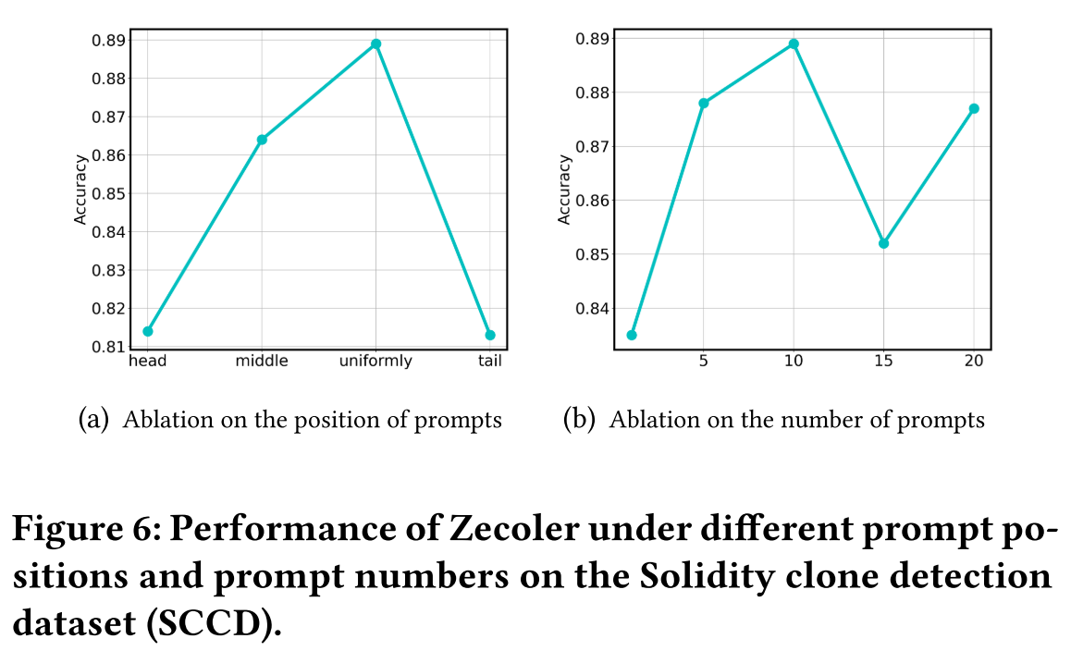
RQ4: Hyperparameter Robustness
The effectiveness of our approach is affected by prompt templates, source languages and PLM scales. Inserting ten prompt tokens uniformly to the original PLM input can steer the PLM to output better representations.
Notes:
The results of RQ4 experiment indicate that the effectiveness of our approach is affected by prompt templates, source languages and PLM scales.

Slide 15
Conclusion
First work on zero-shot learning of program representations.
Cast downstream tasks to MLM by introducing prompts into pre-trained program representation learning.
Outperforms baseline models in both zero-shot and few-shot settings.
Code and data available at: https://github.com/ChrisCN97/zecoler.
Notes:
In summary, this paper ﻿proposes Zecoler, a novel approach for zero-shot program representation learning via prompt tuning. Zecoler improves traditional PLMs by introducing prompt into program representation learning. Experiments show that Zecoler outperforms baseline models in three code intelligence tasks in both zero-shot and few-shot settings. Program representations learned by Zecoler also demonstrate good generalizability for low or zero-resource programming languages.

Slide 16
Thanks for listening!
Contact me: cuinan@sjtu.edu.cn
Notes:
That’s the end of my presentation. If you have any questions, please contact me via this e-mail address. Thanks for listening.

